Slide 1
Compressive Imaging Systems
for Efficient Visual Intelligence
Yaping Zhao

Slide 2
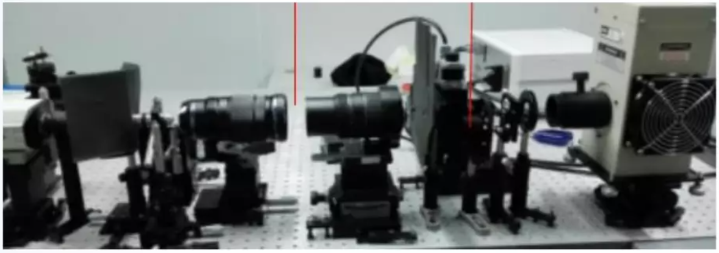
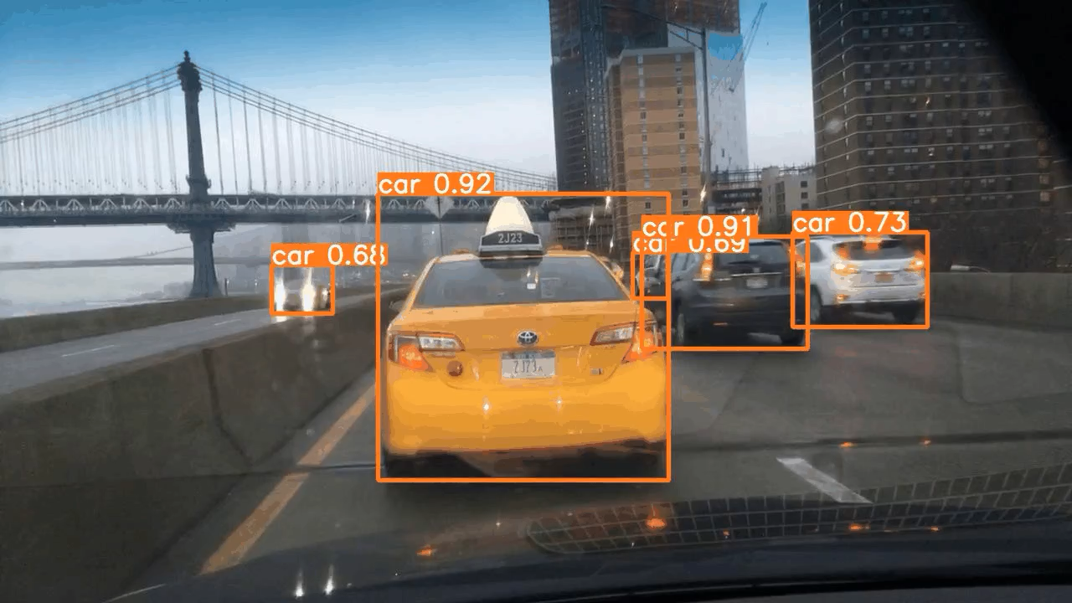
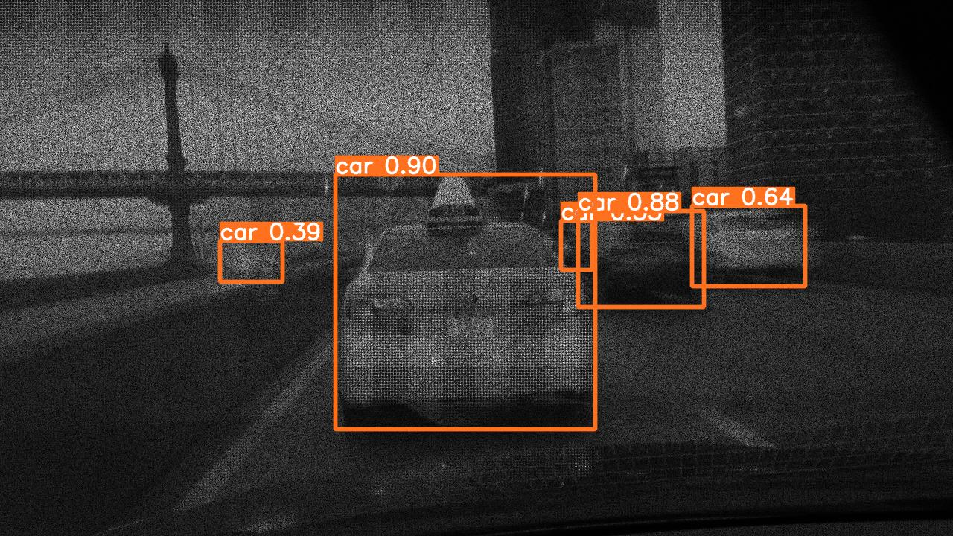
Purpose
Imaging System
Dynamic Scene
Five cars including a prominent yellow taxi are driving down the road.
Captioning
Object Detection
Utilizing Compressive Imaging Systems to achieve Efficient Visual Intelligence, advancing the future of smart cities and automation.
Notes:
利用壓縮成像系統實現高效視覺智能，推動智慧城市和自動化的未來。
Utilizing Compressive Imaging Systems to achieve Efficient Visual Intelligence, advancing the future of smart cities and automation.

Slide 3

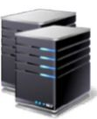

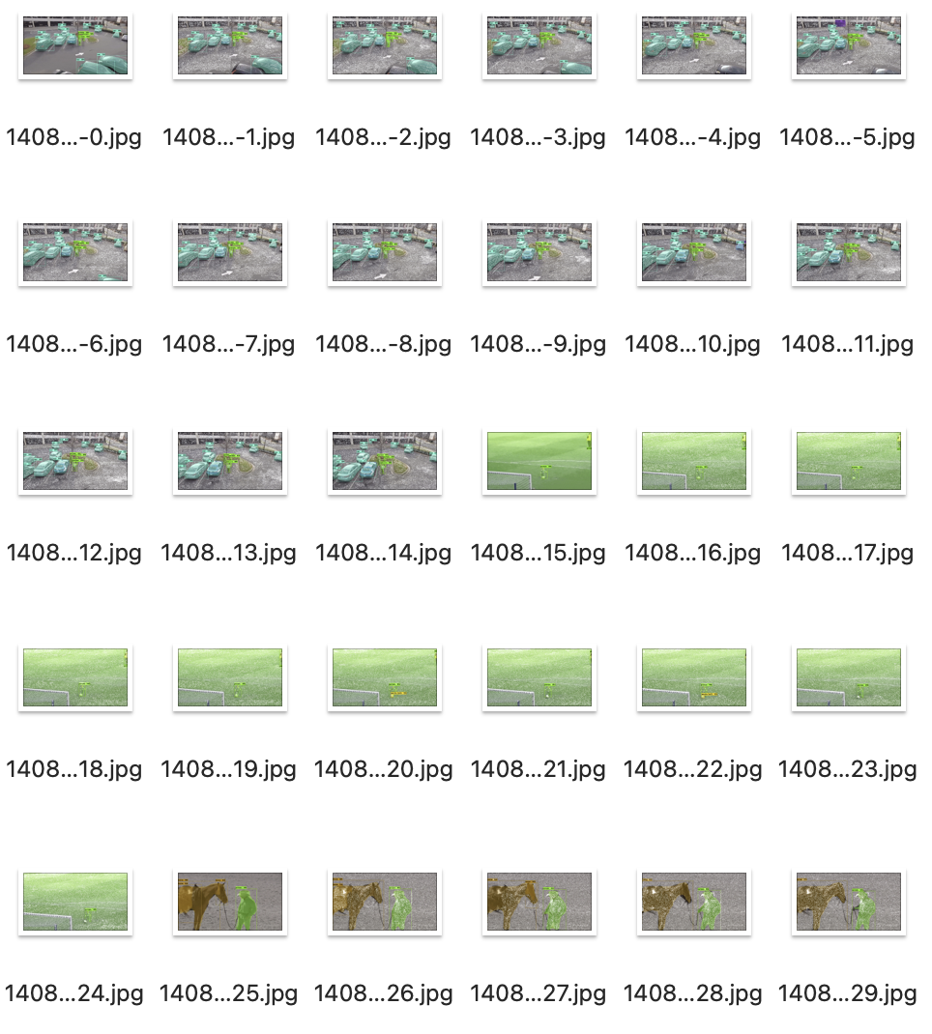
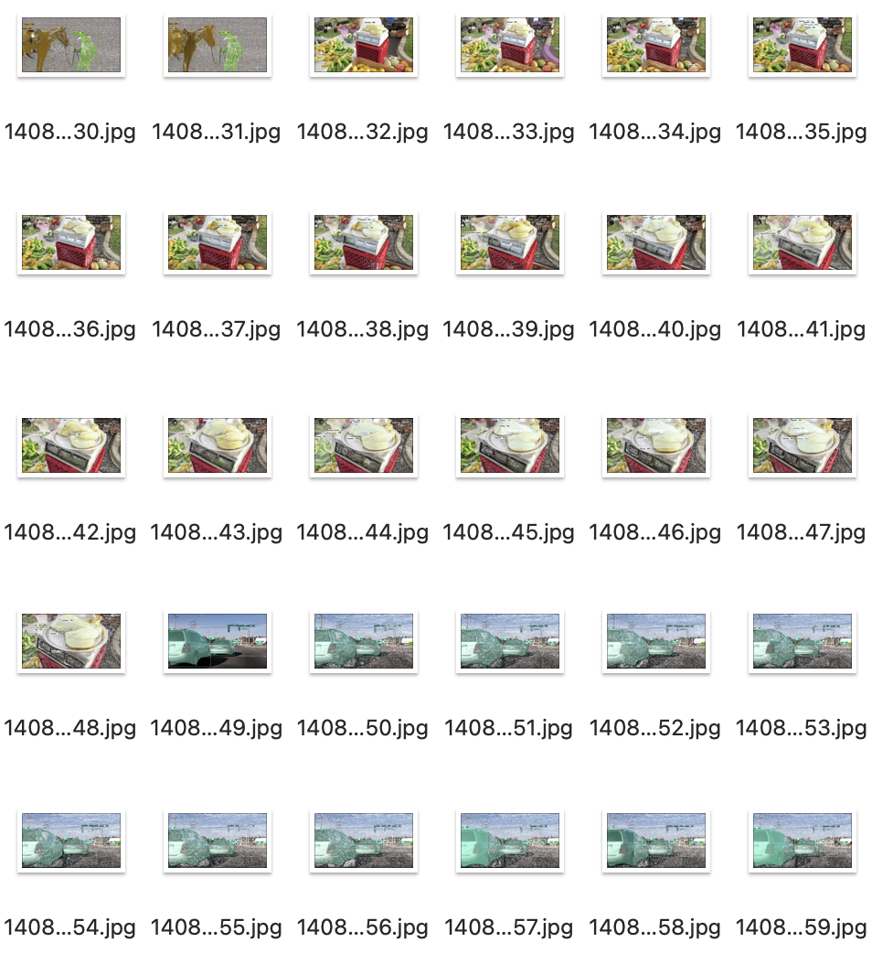
Problem
Current solutions are:
Slow 2. Storage-intensive 3. Higher energy consumption
Notes:
傳統視覺系統處理高維度數據耗時且資源密集。
Traditional visual systems are time-consuming and resource-intensive
when processing high-dimensional data.

Slide 4
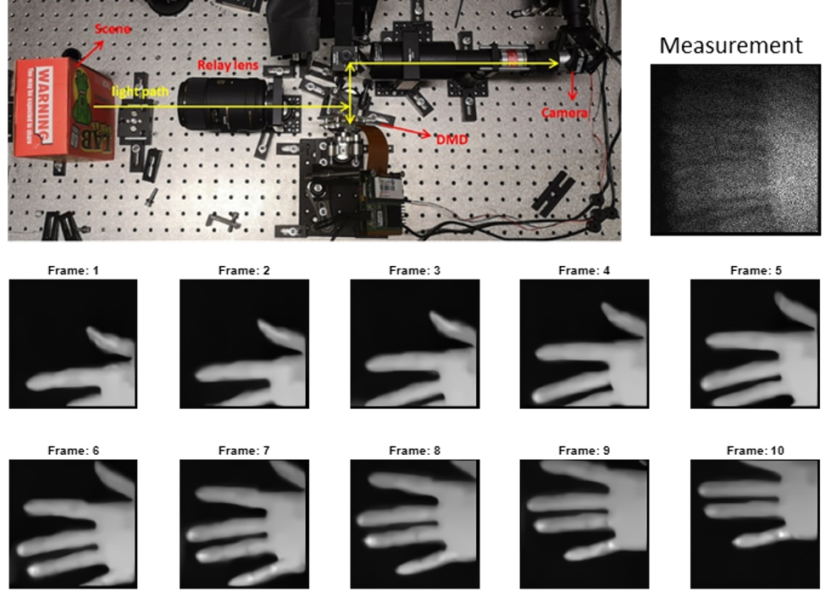
Solution
Fully Automated System
Encoded Optic 2. AI-Driven Processing 3. Millisecond Efficiency
Notes:
Fully Automated System - Supports complete automation in compressive imaging.
Encoded Optics - Implements encoding within optical systems for dynamic video compression.
AI-Driven Processing - Proprietary AI algorithms process data directly in the compressed domain.
Millisecond Efficiency - Achieves high efficiency and accuracy in visual intelligence within milliseconds.
我們的壓縮成像系統直接在壓縮域內處理數據，顯著提高處理速度和效率。
Our compressive imaging system processes data directly in the compressed domain, significantly increasing speed and efficiency.

Slide 5
Solution
Millisecond Efficiency
Object Detection: Hand
Captioning: A hand is shaking.
Notes:
Fully Automated System - Supports complete automation in compressive imaging.
Encoded Optics - Implements encoding within optical systems for dynamic video compression.
AI-Driven Processing - Proprietary AI algorithms process data directly in the compressed domain.
Millisecond Efficiency - Achieves high efficiency and accuracy in visual intelligence within milliseconds.
我們的壓縮成像系統直接在壓縮域內處理數據，顯著提高處理速度和效率。
Our compressive imaging system processes data directly in the compressed domain, significantly increasing speed and efficiency.

Slide 6
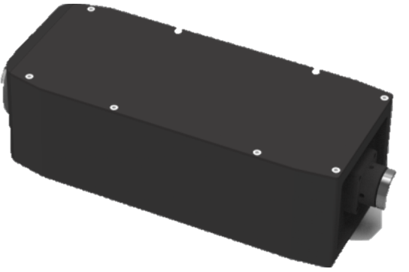
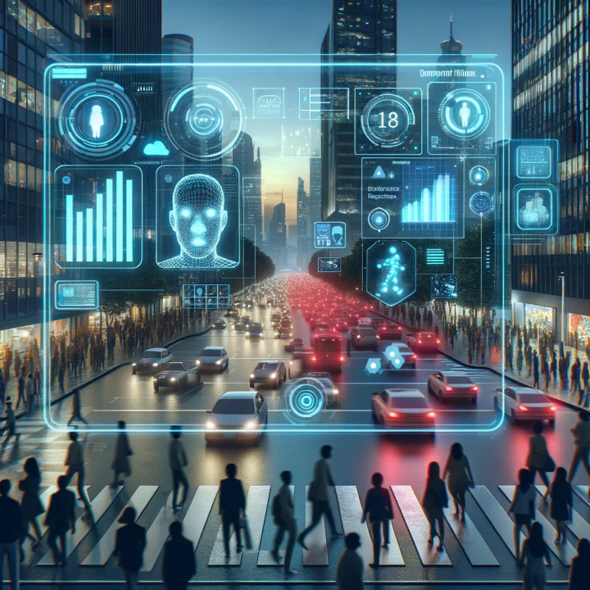
Product
Hardware
Software
Efficient Visual Intelligence System (EVI)
Real-time data processing
Data compression ratio of 10:1
Maintains up to 99% accuracy
Visual Intelligence Software (VIS)
User-Friendly Interface
Customized Solutions
Technical Support
Notes:
Product Name: Efficient Visual Intelligence System (EVI)Function Description:Advanced compressive imaging system
Designed for processing and analyzing high-dimensional visual data
Significantly increases data processing speed and efficiency through real-time data compression
Technical Specifications:Utilizes proprietary algorithms
Achieves a data compression ratio of 10:1
Maintains up to 99% accuracy
Software Platform: Visual Intelligence Software (VIS)
User-Friendly Interface: Provides a user-friendly interface for data monitoring, analysis, and reporting.
Customized Solutions: Offers customized solutions tailored to client needs.
Technical Support: Provides technical support to help clients integrate the EVI system into their existing technology frameworks.

Slide 7
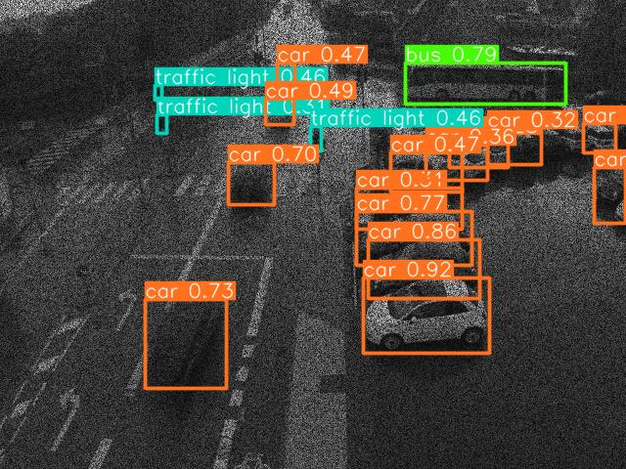
Application Case: Urban Traffic Management
Size (MB): | 5.1 | 0.319
Processing Time (ms): | 108 | 12
Optimize traffic flow monitoring and improve emergency response times.
Notes:
利用壓縮成像系統優化交通流量監控，減少擁堵，提高應急響應速度。
Utilize compressive imaging systems to optimize traffic flow monitoring, reduce congestion, and improve emergency response times.

Slide 8
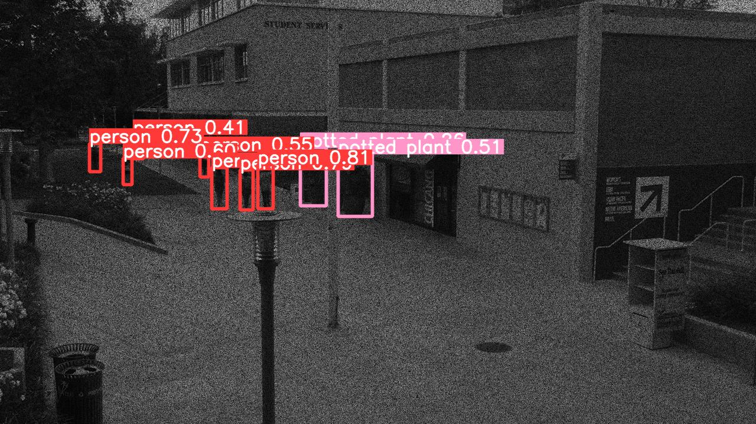
Application Case: Pedestrian Surveillance
Size (MB): | 3.8 | 0.254
Processing Time (ms): | 105 | 11
Enhance public safety with real-time monitoring and incident prevention.
Notes:
在公共安全領域，通過壓縮成像技術實現實時行人監控，增強公共場所安全。In public safety, implement real-time pedestrian monitoring through compressive imaging technology to enhance security in public areas.
Real-Time Monitoring: Implements real-time pedestrian monitoring using compressive imaging technology.Enhanced Security: Enhances security measures in public areas.Public Safety Improvement: Utilizes advanced imaging solutions to improve overall public safety.
Real-Time Pedestrian Monitoring: Implements real-time monitoring of pedestrian movement through advanced compressive imaging technology, ensuring immediate response capability.
Public Area Surveillance: Enhances the safety of public spaces by providing detailed and continuous surveillance without the need for extensive hardware setups.
Incident Prevention and Response: Utilizes the high-resolution and fast processing capabilities of compressive imaging to identify potential security threats early and aid in quick response strategies.
One sentence. Find some real-world examples to make the story reliable

Slide 9
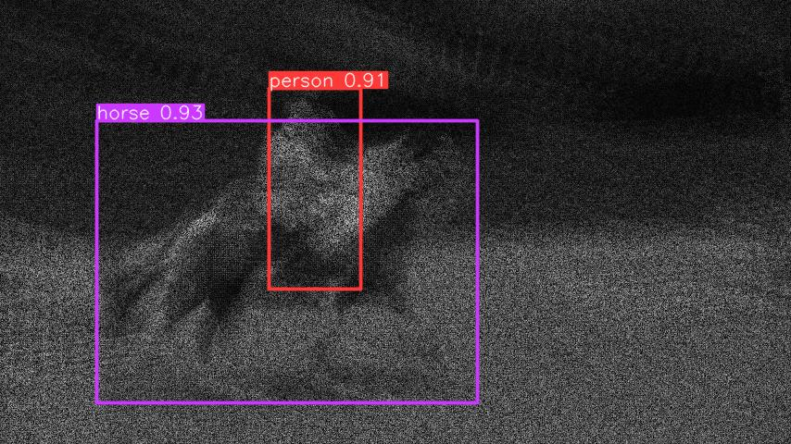
Application Case: Sports Intelligent Commentary
A rider is mounted on a galloping horse.
Size (MB): | 2.6 | 0.265
Processing Time (ms): | 235 | 17
Enhance viewer experience with automatic highlight identification and analysis.
Notes:
為體育賽事提供智能解說，通過壓縮成像技術自動識別和分析比賽精彩瞬間。Provide intelligent commentary for sporting events, with automatic identification and analysis of highlights through compressive imaging.
Automatic Highlight Identification: Utilizes compressive imaging technology to automatically identify and analyze key moments in sporting events.Enhanced Viewer Experience: Provides audiences with intelligent commentary that enhances the viewing experience by highlighting critical plays and pivotal moments.Real-Time Analysis: Offers real-time analysis and insights, making complex play strategies and performances easily understandable for viewers.

Slide 10
Roadmap
Current Stage
Future Stage
Released new version.
Official product launch and sales commencement.
Began field testing with early adopters.
Completed initial R&D and internal testing.
2024 Q3
2024 Q4
2025 Q2
2025 Q4
Notes:
目標市場為智慧城市、安全監控和自動駕駛領域，市場需求持續增長。
The target market includes smart cities, security surveillance, and autonomous driving, with continuously growing demand.

